Slide 1
Computer Simulation and Modeling
Simulation of PERT Network

Slide 2
Introduction
Program (Project) Evaluation and Review Technique (PERT)
project management tool used to
schedule,
organize, and
coordinate tasks within a project.

Slide 3
Description
PERT planning involves the following steps:
Identify the specific activities and milestones:
The activities are the tasks required to complete a project.
The milestones are the events marking the beginning and the end of one or more activities.
Determine the proper sequence of the activities.

Slide 4
Description
Construct a network diagram:
a network diagram can be drawn showing the sequence of the serial and parallel activities.
Estimate the time required for each activity:
For each activity, the model usually includes three time estimates:
Optimistic time – generally the shortest time in which the activity can be completed.

Slide 5
Description
Most likely time – the completion time having the highest probability. It is different from expected time.
Pessimistic time – the longest time that an activity might require. Three standard deviations from the mean is commonly used for the pessimistic time.
Expected time = ( Optimistic + 4 x Most likely + Pessimistic ) / 6
This expected time may be displayed on the network diagram.
Variance= [ ( Pessimistic - Optimistic ) / 6 ]²

Slide 6
Description
Determine the critical path:
The critical path is determined by adding the times for the activities in each sequence and determining the longest path in the project.
ES – Earliest Start time
EF - Earliest Finish time
LS – Latest Start time
LF - Latest Finish time
The earliest start and finish times of each activity are determined by working forward through the network .
The latest start and finish times are the latest times that an activity can start and finish without delaying the project.
The critical path is the path through the network in which none of the activities have slack.

Slide 7
Description
Update the PERT chart as the project progresses.
Make adjustments in the PERT chart as the project progresses.
As the project unfolds, the estimated times can be replaced with actual times.

Slide 8
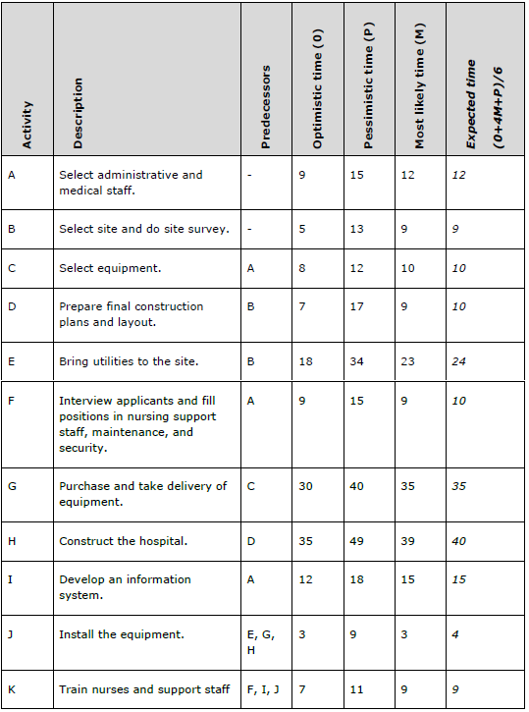

Slide 9
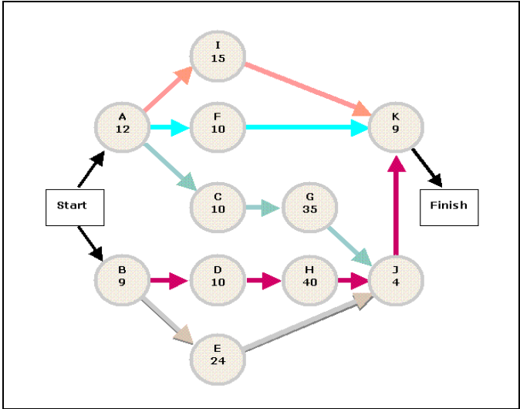

Slide 10
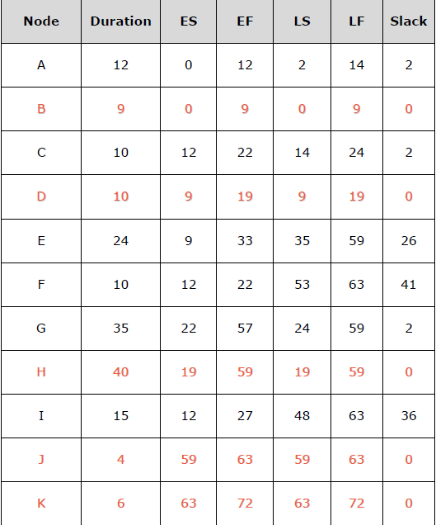

Slide 11
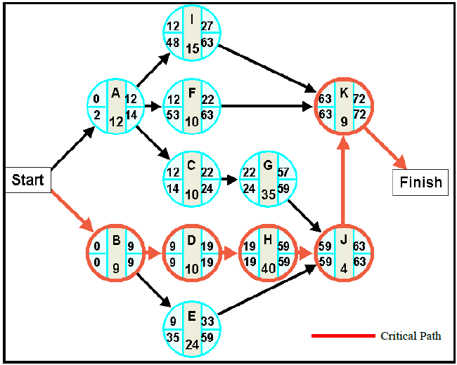

Slide 12
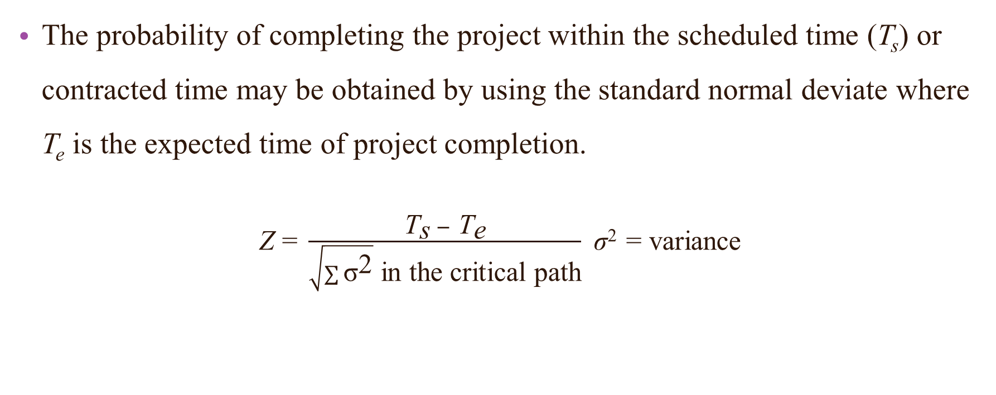
Probability for Project Duration
The probability of completing the project within the scheduled time (T_{s}) or contracted time may be obtained by using the standard normal deviate where T_{e} is the expected time of project completion.
$\text{Z}\text{ = }\frac{{\text{T}}_{\text{s}} − {\text{T}}_{\text{e}}}{\sqrt{\sum{{\text{σ}}^{\text{2}}}} \text{in} \text{the} \text{critical} \text{path}}$ σ² = variance

Slide 13
Project Crashing
Procedure for crashing
Step 1: Draw the network diagram and mark the Normal time and crash time
Step 2: Calculate TE and TL for all the activities
Step 3: Find the critical path and other paths
Step 4: Find the cost slope for all activities and rank them in ascending order
Step 5: Select among the activities on critical path an activity which has least cost slope. For more than one critical path select one activity on each critical path such that total cost of crashing all these activities is minimum among all such combinations of activities.

Slide 14
Project Crashing
Step 6: Reduce the activity time of the selected activity progressively until either crashed time is reached or the previous non-critical parallel path becomes critical
Step 7: Proceed above steps until there is at least one critical path on which none of the activities can be further crashed

Slide 15
Project Crashing
Activity | Normal |  | Crash
 | Time (days) | Cost (Rs) | Time (days) | Cost (Rs)
1-2 | 6 | 50 | 4 | 80
1-3 | 5 | 80 | 3 | 150
2-4 | 5 | 60 | 2 | 90
2-5 | 8 | 100 | 6 | 300
3-4 | 5 | 140 | 2 | 200
4-5 | 2 | 60 | 1 | 80

Slide 16
Project Crashing
6
6
14
14
8
2
5
0
0
6
5
1
2
5
3
4
5
5
7
11
12
Activity | Normal time | Crash time | Cost slope | Rank
1-2 | 6 | 4 | 15 | 2
1-3 | 5 | 3 | 35 | 4
2-4 | 5 | 2 | 10 | 1
2-5 | 8 | 6 | 100 | 5
3-4 | 5 | 2 | 20 | 3
4-5 | 2 | 1 | 20 | 3

Slide 17
Project Crashing
Activity Crashed | Project Duration | Critical Path | Direct Cost d | Indirect Cost i | Total Cost d+i
- | 14 | 1-2-5 | 490 | 14X20 = 280 | 770

Slide 18
Project Crashing
This can be reduced to 7
2
8
This can be reduced to 2
1
6
5
3
This can be reduced to 3
Here, 1-3-2 is the critical path.
If we choose 1-3 reduced to 3 and 3-2 reduced to 2 then 1-3-2 does not remain critical path any more.
Because total time in path 1-3-2 is 5 whereas 1-2 can be reduced upto 7.
So we have to choose in such a way that the total time becomes 7 in both directions.

Slide 19
Project Crashing
6
6
14
14
As 2-4 has rank 1, we had to choose it to be reduced. But it is not in the critical path. So we have to choose 1-2(next rank).
8
2
5
0
0
6
5
1
2
5
3
4
5
5
7
11
12
Activity | Normal time | Crash time | Cost slope | Rank
1-2 | 6 | 4 | 15 | 2
1-3 | 5 | 3 | 35 | 4
2-4 | 5 | 2 | 10 | 1
2-5 | 8 | 6 | 100 | 5
3-4 | 5 | 2 | 20 | 3
4-5 | 2 | 1 | 20 | 3

Slide 20
Project Crashing
4
6
12
12
If we choose 1-2 reduced to 4, we have to check whether other path has more time than the critical path.
4
8
2
5
0
0
6
5
1
2
5
3
4
5
5
5
10
10
Activity | Normal time | Crash time | Cost slope | Rank
1-2 | 6 | 4 | 15 | 2
1-3 | 5 | 3 | 35 | 4
2-4 | 5 | 2 | 10 | 1
2-5 | 8 | 6 | 100 | 5
3-4 | 5 | 2 | 20 | 3
4-5 | 2 | 1 | 20 | 3

Slide 21
Project Crashing
4
6
12
12
As there is no problem, 1-2 has been reduced to 4. Then 1-3-4-5 has become a critical path.
4
8
2
5
0
0
6
5
1
2
5
3
4
5
5
5
10
10
Activity | Normal time | Crash time | Cost slope | Rank
1-2 | 6 | 4 | 15 | 2
1-3 | 5 | 3 | 35 | 4
2-4 | 5 | 2 | 10 | 1
2-5 | 8 | 6 | 100 | 5
3-4 | 5 | 2 | 20 | 3
4-5 | 2 | 1 | 20 | 3

Slide 22
Project Crashing
Activity Crashed | Project Duration | Critical Path | Direct Cost d | Indirect Cost i | Total Cost d+i
- | 14 | 1-2-5 | 490 | 14X20 = 280 | 770
1-2(1) | 13 | 1-2-5 | 490+(1X15) = 505 | 13X20 = 260 | 765
1-2(1) | 12 | 1-2-5 1-3-4-5 | 505+(1X15) = 520 | 12X20 = 240 | 760

Slide 23
Project Crashing
4
4
12
12
Again we have to check 2-4, then 1-2. As 2-4 is not in critical path and 1-2 has been reduced to the limit, we have to consider rank 3. We can choose any of them.
4
8
2
5
0
0
6
5
1
2
5
3
4
5
5
5
10
10
Activity | Normal time | Crash time | Cost slope | Rank
1-2 | 6 | 4 | 15 | 2
1-3 | 5 | 3 | 35 | 4
2-4 | 5 | 2 | 10 | 1
2-5 | 8 | 6 | 100 | 5
3-4 | 5 | 2 | 20 | 3
4-5 | 2 | 1 | 20 | 3

Slide 24
Project Crashing
4
4
11
11
Let us choose 4-5 be reduced to 1, then to keep 1-2-5 critical path we have to reduce 2-5 to 7 simultaneously.
7
4
8
2
5
0
0
6
5
1
2
1
5
3
4
5
5
5
10
10
Activity | Normal time | Crash time | Cost slope | Rank
1-2 | 6 | 4 | 15 | 2
1-3 | 5 | 3 | 35 | 4
2-4 | 5 | 2 | 10 | 1
2-5 | 8 | 6 | 100 | 5
3-4 | 5 | 2 | 20 | 3
4-5 | 2 | 1 | 20 | 3

Slide 25
Project Crashing
***
4
4
11
11
But if we would choose 3-4 to be reduced to 4 and we had to reduce 2-5 to 7 to keep it critical, then 1-2-4-5 would become critical path.
7
4
8
2
5
0
0
6
5
1
2
5
3
4
5
4
9
9
5
5
Activity | Normal time | Crash time | Cost slope | Rank
1-2 | 6 | 4 | 15 | 2
1-3 | 5 | 3 | 35 | 4
2-4 | 5 | 2 | 10 | 1
2-5 | 8 | 6 | 100 | 5
3-4 | 5 | 2 | 20 | 3
4-5 | 2 | 1 | 20 | 3

Slide 26
Project Crashing
Activity Crashed | Project Duration | Critical Path | Direct Cost d | Indirect Cost i | Total Cost d+i
- | 14 | 1-2-5 | 490 | 14X20 = 280 | 770
1-2(1) | 13 | 1-2-5 | 490+(1X15) = 505 | 13X20 = 260 | 765
1-2(1) | 12 | 1-2-5 1-3-4-5 | 505+(1X15) = 520 | 12X20 = 240 | 760
2-5(1) 3-4(1) | 11 | 1-2-5 1-3-4-5 1-2-4-5 | 520+(1X100)+(1X20) = 640 | 11X20 = 220 | 860

Slide 27
Project Crashing
4
4
10
10
All paths have become critical; still we have to check whether the paths can be reduced simultaneously.
We have to start checking rank-wise.
7
6
4
8
2
5
0
0
6
5
4
1
2
5
3
4
5
After the above step no more reduction can be possible
4
3
8
8
5
5
Activity | Normal time | Crash time | Cost slope | Rank
1-2 | 6 | 4 | 15 | 2
1-3 | 5 | 3 | 35 | 4
2-4 | 5 | 2 | 10 | 1
2-5 | 8 | 6 | 100 | 5
3-4 | 5 | 2 | 20 | 3
4-5 | 2 | 1 | 20 | 3

Slide 28
Project Crashing
Activity Crashed | Project Duration | Critical Path | Direct Cost d | Indirect Cost i | Total Cost d+i
- | 14 | 1-2-5 | 490 | 14X20 = 280 | 770
1-2(1) | 13 | 1-2-5 | 490+(1X15) = 505 | 13X20 = 260 | 765
1-2(1) | 12 | 1-2-5 1-3-4-5 | 505+(1X15) = 520 | 12X20 = 240 | 760
2-5(1) 3-4(1) | 11 | 1-2-5 1-3-4-5 1-2-4-5 | 520+(1X100)+(1X20) = 640 | 11X20 = 220 | 860
2-5(1) 2-4(1) 3-4(1) | 10 | 1-2-5 1-3-4-5 1-2-4-5 | 640+(1X100)+(1X10)+ (1X20) = 770 | 10X20 = 200 | 970

